Slide 1
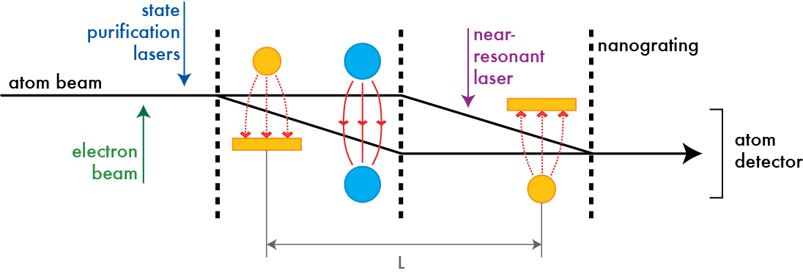

Polarizability and magic-zero wavelength measurements of alkali atoms
Will Holmgren
Ph.D. Thesis Defense
Cronin group, Department of Physics
4/2/2013

Slide 2
What happens to an atom in an electric field?
1000 V
0 V
+
0 V

Slide 3
Atoms and Quantum Mechanics
He
1.4 a₀³
Na
160 a₀³
Rb
320 a₀³
+
+
+
2nd order perturbation theory:

Slide 4
Motivations
Test atomic structure calculations
Mitroy et al (2010)
Reduce uncertainty in atomic clock BBR shifts
Ludlow et al (2008)
Support parity non-conservation experiments
Porsev et al (2009)

Slide 6
ATOMIC AND MOLECULAR POLARIZABILITIES
Thomas M. Miller

Slide 7
TABLE 1. Formulas Involving Polarizability

Slide 8
van der Waals int.
Rayleigh scattering
Dielectric constant
Notes:
Van der waals: why geckos can climb walls and why vincent has a ph d
Rayleigh scattering: why the sky is blue
Dielectric constant hugely important descriptor of material properties

Slide 9
TABLE 2. Static Average Electric Dipole Polarizabilities
for Ground State Atoms (in Units of 10⁻²⁴ cm³)

Slide 10
TABLE 2. Static Average Electric Dipole Polarizabilities
for Ground State Atoms (in Units of 10⁻²⁴ cm³)

Slide 11
Holmgren et al.
PRA 2010

Slide 12
This thesis
Measured static polarizabilities of Na, K, Rb
with 0.3% precision [PRA 2010]
New measurement tool: phase choppers
Demonstrated 0.05% uncertainty measurement of atom velocity [NJP 2011]
New experiment: Magic-zero wavelength measurement of K
(where α(ω_{zero})=0) [PRL 2012]

Slide 13
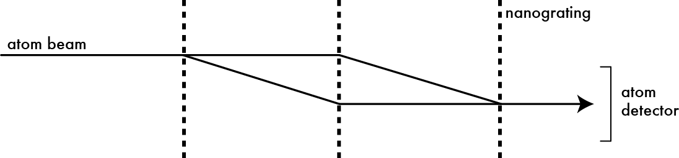
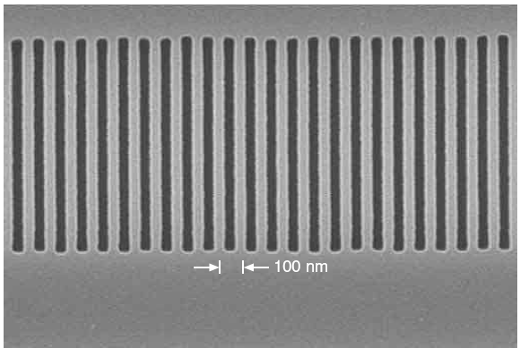
How do we measure polarizabilities? With an atom interferometer…
100 nm period
Notes:
Draw |a|psi0>+b|psi1>|^2 on board

Slide 14
How do we measure polarizabilities? With an atom interferometer…
100 nm period
Notes:
Draw |a|psi0>+b|psi1>|^2 on board

Slide 15
How do we measure polarizabilities? With an atom interferometer…
100 nm period
Notes:
Draw |a|psi0>+b|psi1>|^2 on board

Slide 16
How do we measure polarizabilities? With an atom interferometer…
100 nm period
Notes:
Draw |a|psi0>+b|psi1>|^2 on board

Slide 17

How do we measure polarizabilities? With an atom interferometer…
100 nm period

Slide 18
How do we measure polarizabilities? With an atom interferometer…
counts/sec
100 nm period
grating position
Notes:
Draw |a|psi0>+b|psi1>|^2 on board

Slide 19
How do we measure polarizabilities? With an atom interferometer…
counts/sec
grating position

Slide 20
How do we measure polarizabilities? With an atom interferometer…
counts/sec
grating position
Notes:
2000 rad along this path and 1999 rad along this path shows up as a 1 rad phase shift. Contrast changes because the phase shift depends on atom beam velocity and different atoms in the beam have different velocities.

Slide 21
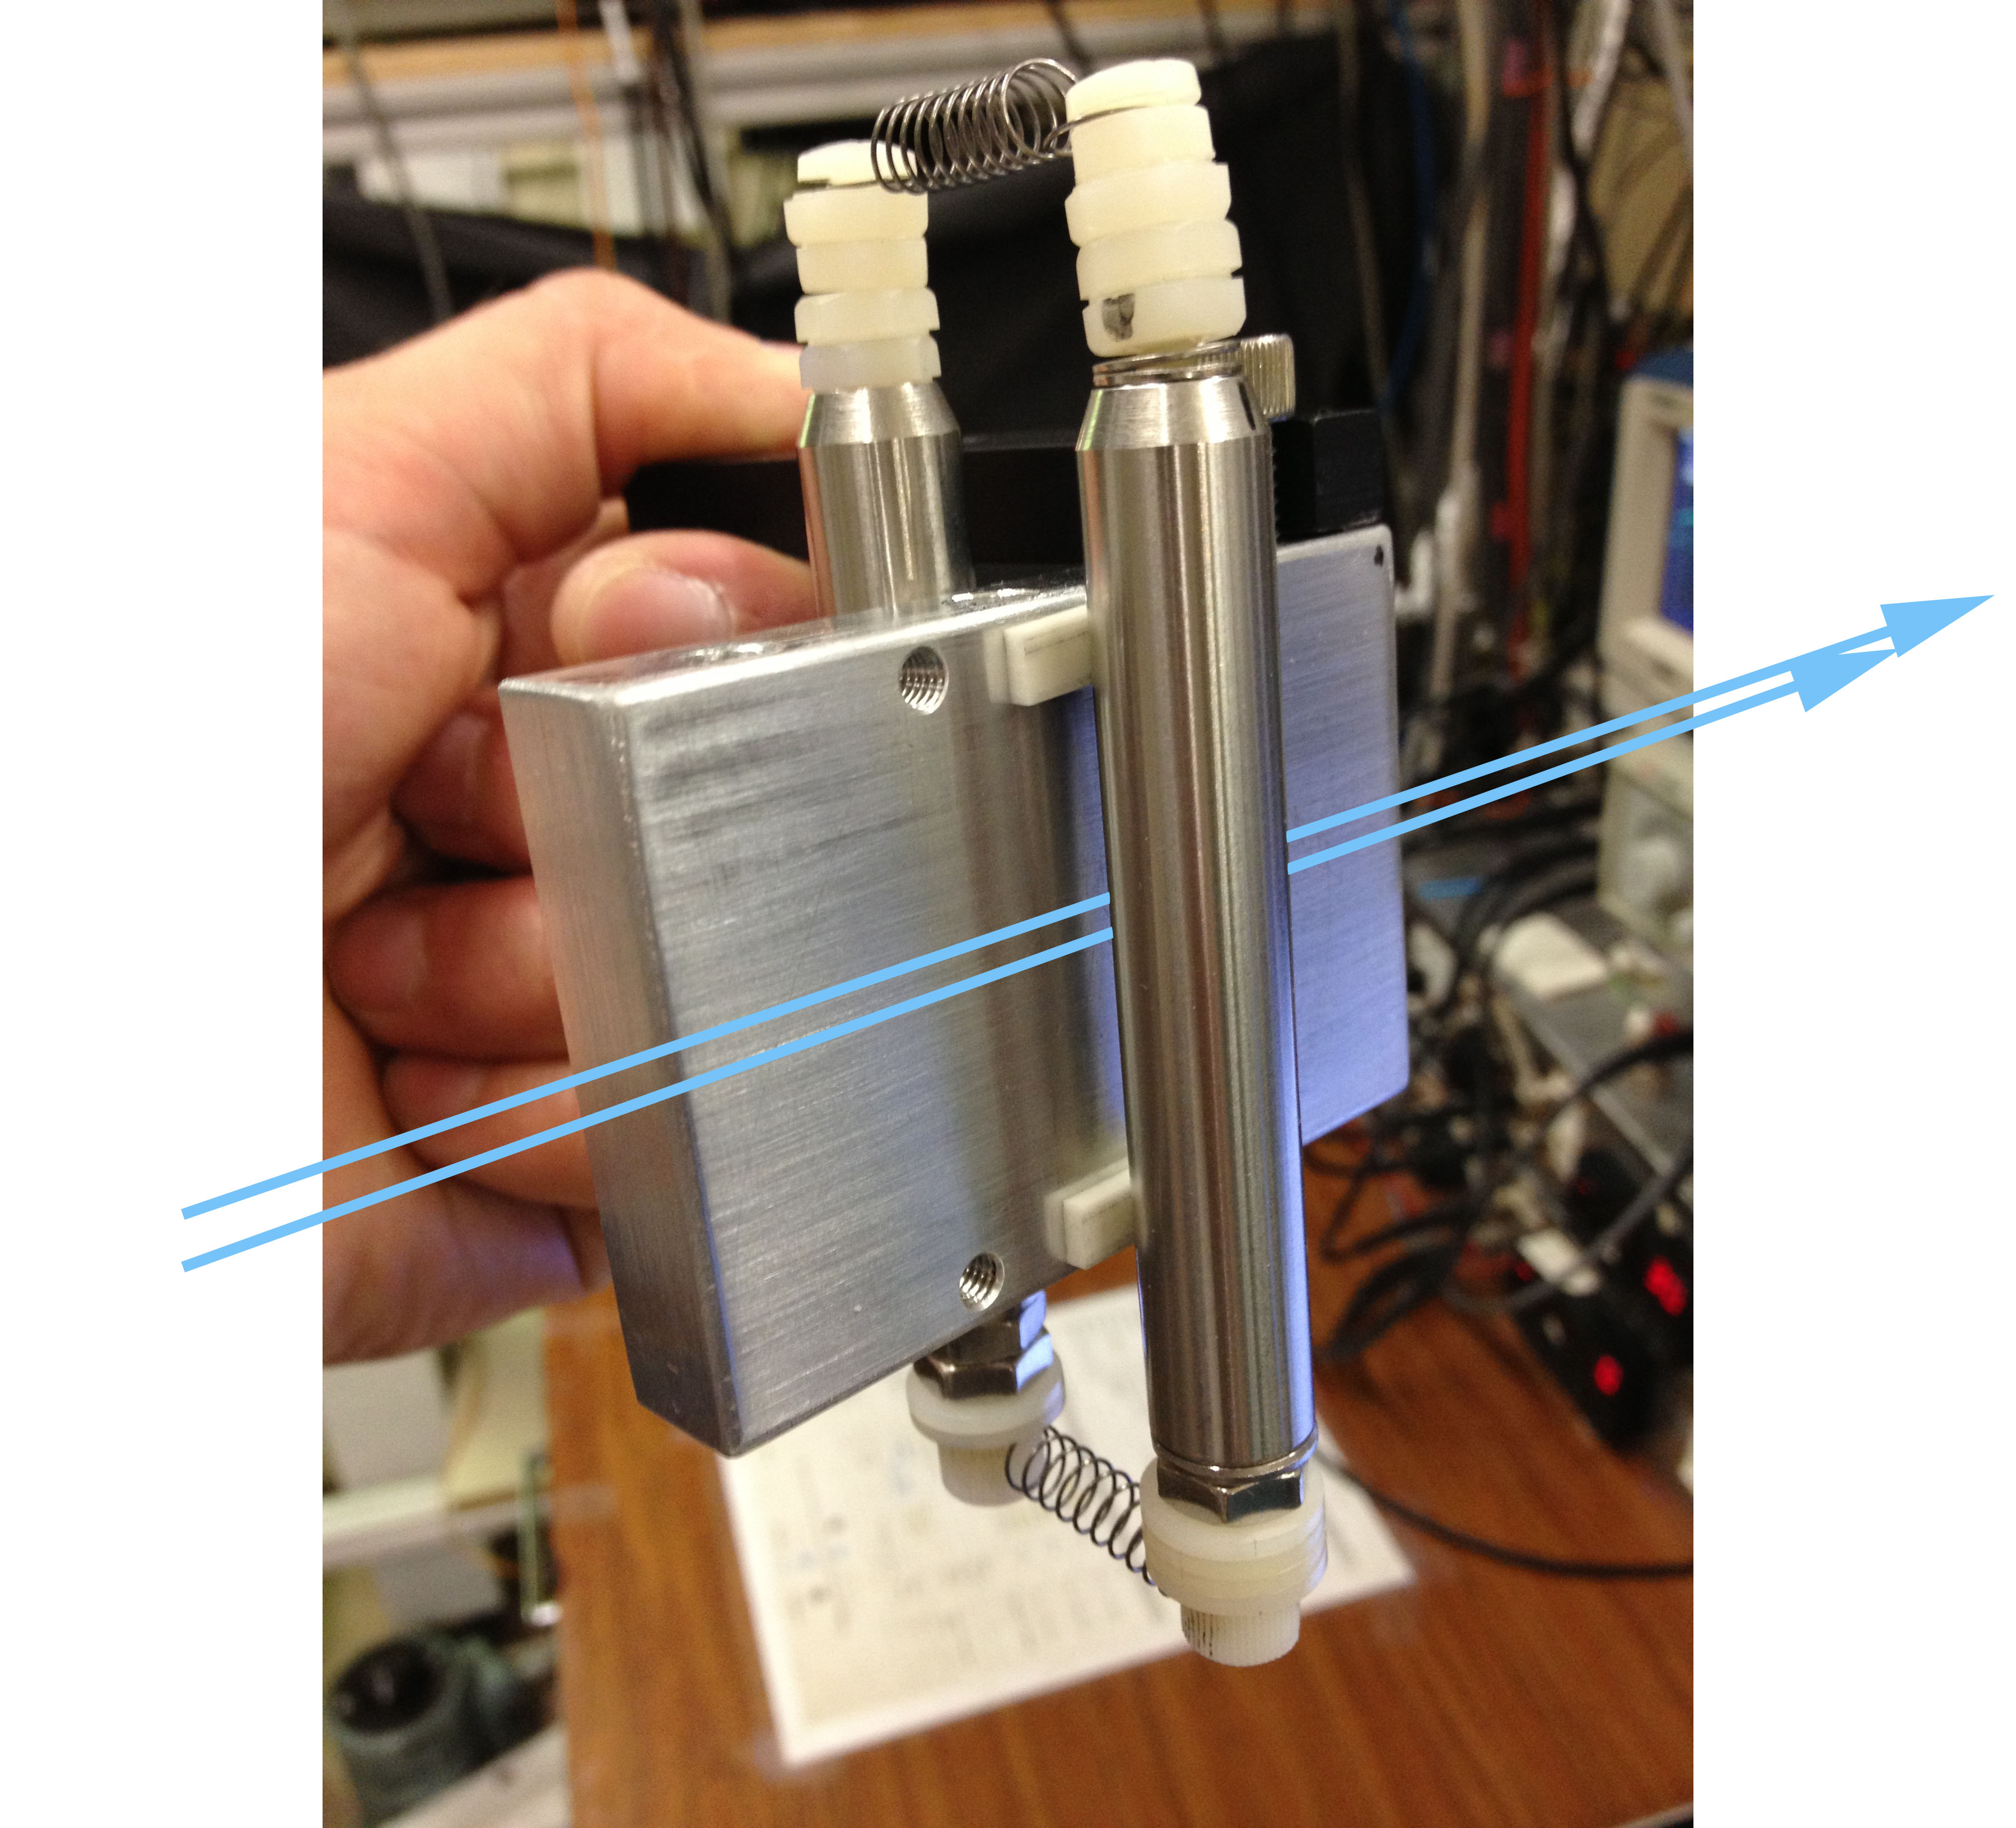
Pol. measurement interaction region

Slide 22
Complications
Velocity distribution
Multiple diffraction orders
Sagnac phase
Beam thickness
Many fringe patterns add incoherently to yield the observed fringes
Notes:
Of course, in reality, the experiment is significantly more complicated than the previous cartoon suggests. Each of these complications introducing a type of averaging to the measured phase shift that we must account for.
First, the supersonic beam of atoms is not traveling at one single velocity, but has a velocity distribution that modifies the measured phase shift by up to 5%. Second, we’re using material gratings to diffract the atoms, so there are multiple diffraction orders from each grating, and thus multiple interferometers are formed and detected. Third, the earth, and thus the nano-gratings, rotate under the atom beam as it traverses the interferometer. This rotation leads to a Sagnac phase shift that we must account for as well. Finally, the finite beam thickness also modifies the measured phase shift.

Slide 23
Atom beam velocity measurement
Measure de Broglie wavelength using atom beam diffraction
Rb
detector
nanograting
K
Atom
beam
Counts/sec
Na
Detector position

Slide 24
Phase and contrast measurements
Phase shift
Contrast
Beam position
Notes:
Here is an example of a typical data set that we analyze to find polarizability. Here I’m showing the phase shift and contrast of the atom fringes vs the beam position inside the electric field gradient region. Fitting this data yields the polarizability.

Slide 25
Polarizability measurements
Statistical uncertainty
0.3%
Systematic uncertainty
0.9%
Notes:
Here are the results of many polarizability measurements for sodium, potassium, and rubidium. Each of these roughly 50 measurements represents about 30 minutes of data. We achieve a statistical uncertainty of about 0.3% and a systematic uncertainty of 0.9%.
The systematics are very nearly the same for all three atoms, so we can present ratio measurements with higher precision.

Slide 26
Testing theory with α ratios
Our measurements
0.3% precision
Notes:
Here are our ratio measurements of polarizabilities on the far right compared to theory (open circles) and experiment (filled circles) over the last 35 years. You can see that there is quite a spread in the polarizability calculations and our ratio measurements have, for the first time, sufficient precision to distinguish between many of these calculations.

Slide 27
Combining ratio and absolute measurements
Our ratio measurements
Ekstrom/Pritchard absolute α_{Na}
Best measurement uncertainty
x
=
x
=
0.3%
0.4%
0.5%
Notes:
Finally, we can combine our ratio measurements with the Ekstrom and Pritchard sodium polarizability measurement to yield 0.5% measurements of rubidium and potassium polarizabilities.

Slide 28
What limits the uncertainty in α?
Notes:
So what limits the uncertainty in our measurements? The velocity, velocity distribution, electrode voltage, beam position and beam width all contribute systematic uncertainty to our measurements. Nearly all of that systematic uncertainty can be eliminated in ratio measurements. Our ratio measurements are currently limited by statistics. Finally, the total measurement uncertainty in potassium and rubidium is limited by the earlier measurement of sodium polarizability.

Slide 29
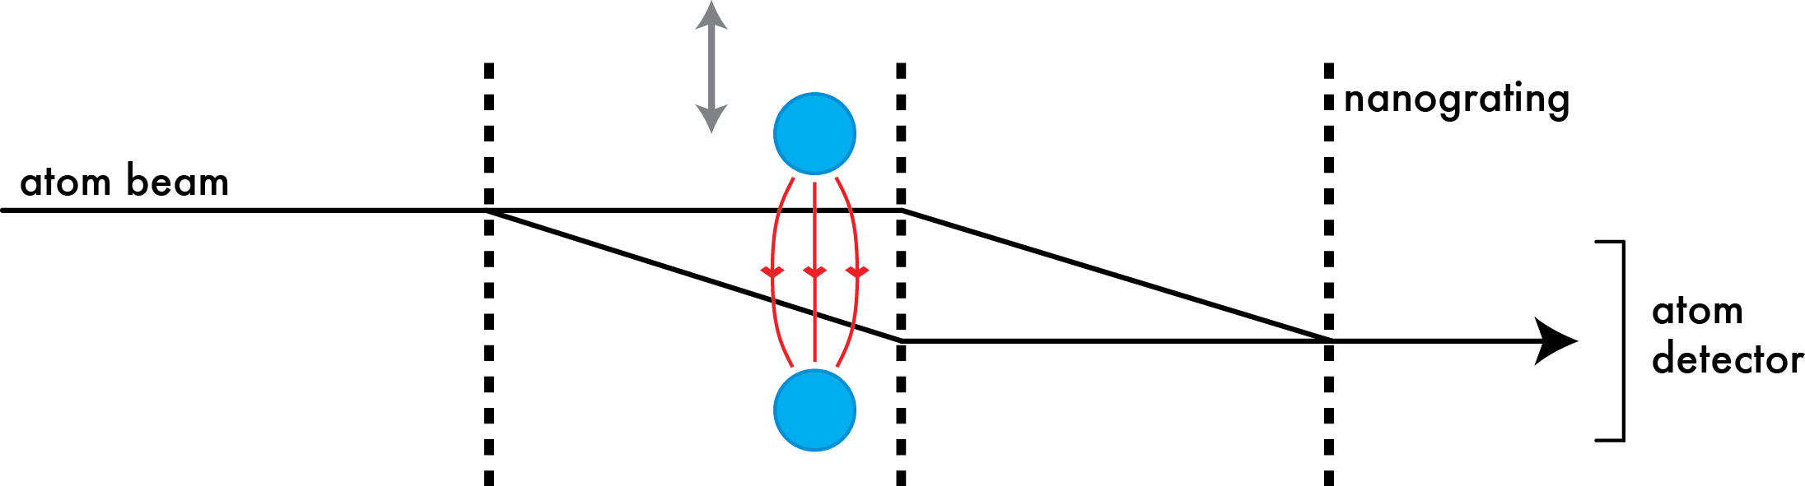
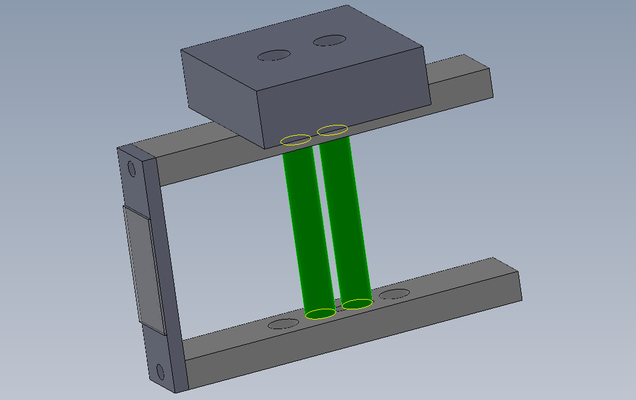
Next generation experiment
Holmgren et al PRA 2010
1.0% uncertainty
0.3% precision (Na, K, Rb)
Hromada et al 2012 preliminary
1.0% uncertainty
0.08% precision (Li, Na, K, Cs)

Slide 30
Phase shift measurements with 2 pillars
Phase shift (rad)
Electrode position (mm)

Slide 31
Cesium polarizability measurements
1 ppt in 1 day!

Slide 32
Phase choppers for velocity measurement
Pulsed electric fields periodically apply π phase shifts
Interferometer contrast oscillates as we change the chopping frequency f
Max contrast when f = n v/L = n f₀
Published in: Holmgren et al. NJP 2011

Slide 33
Phase choppers for velocity measurement
Pulsed electric fields periodically apply π phase shifts
Interferometer contrast oscillates as we change the chopping frequency f
Max contrast when f = n v/L = n f₀

Slide 34
Phase choppers for velocity measurement
Higher precision in less time
Frequency-based instead of length based
No need for well-separated diffraction orders → higher mass atoms
in situ measurement of beam velocity
No moving parts

Slide 35
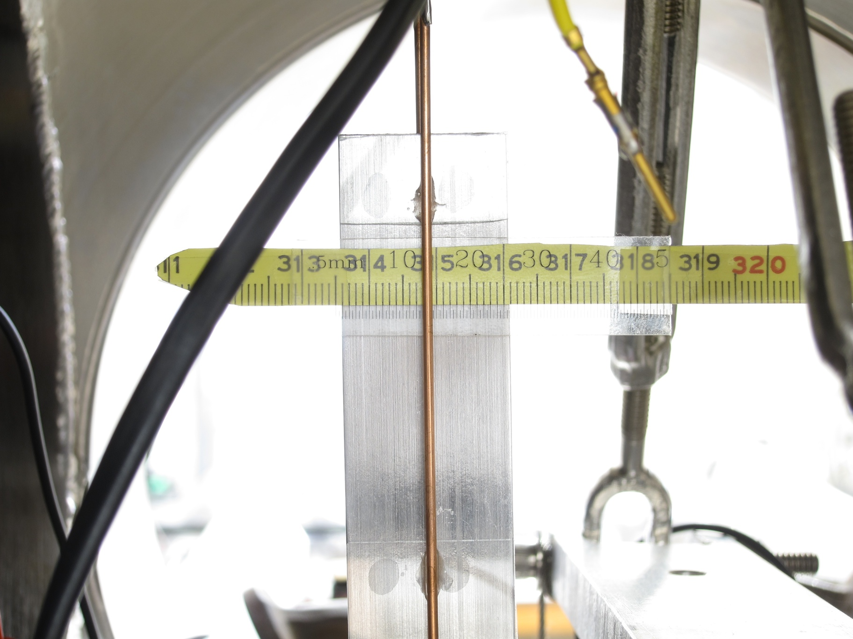
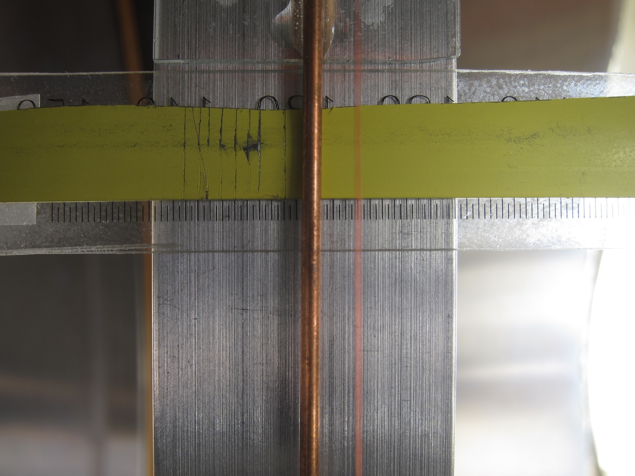
Choppers distance measurement
L=1270.68 (25) mm
Chopper 2
Chopper 1

Slide 36
Chopper contrast and phase data

Slide 37
Chopper contrast and phase data: f₀
Position
Time
f₀

Slide 38
Chopper contrast and phase data: f₀/2
f₀/2

Slide 39
Chopper contrast and phase data: f₀/4
f₀/4

Slide 40
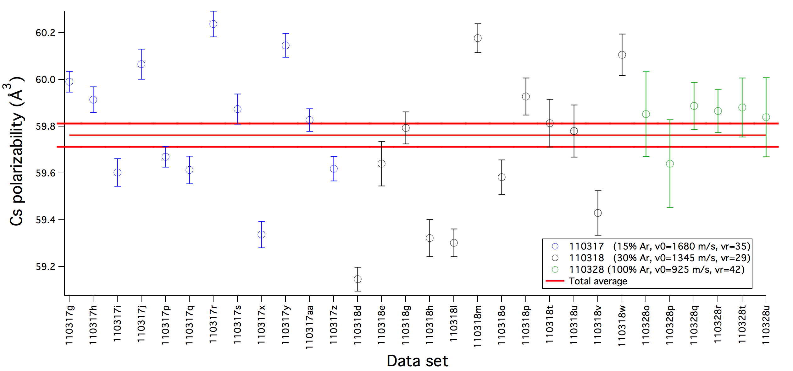
1 ppt precision α_{Cs} at 3 velocities
α_{Cs}=59.76(5) Å³
(stat. only)
1680 m/s
1345 m/s
925 m/s
Notes:
59.76(5)

Slide 41
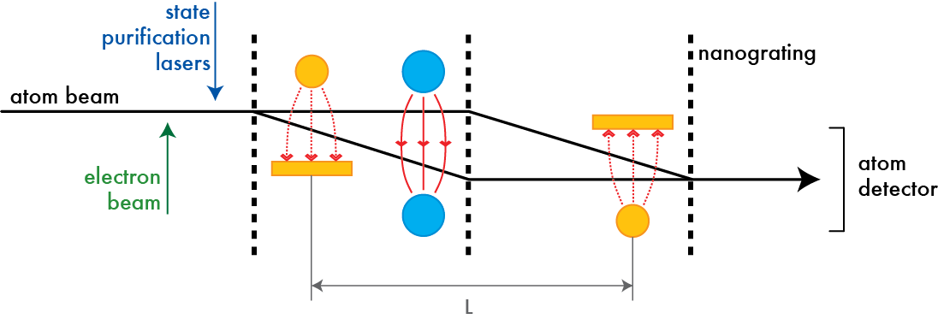
Sr and Yb polarizability measurements
Goal: measure
and
Developing a resonance-enhanced multi-photon ionization scheme
Electron bombardment to promote atoms to the triplet manifold
Lasers to pump atoms into ³P₀ state
State-sensitive detection of the ³P₀ state

Slide 42
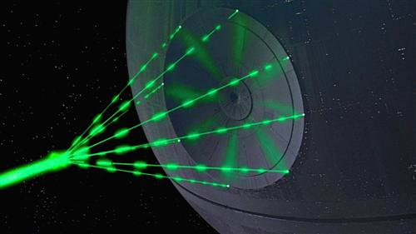
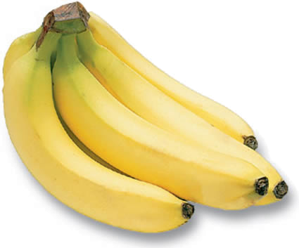
A new experiment: measurement of a magic-zero wavelength

Slide 43
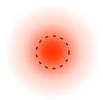
Measurement of a magic-zero wavelength
laser
beam
Published in: Holmgren et al. PRL 2012
Notes:
My name is Will Holmgren and I work with Alex Cronin’s group at the University of Arizona to make high precision measurements of polarizabilities using an atom interferometer. Today I’m going to discuss a new kind of high precision polarizability measurement: a measurement of the so-called tune-out wavelength at which the dynamic polarizability of an atom equals 0.

Slide 44
What’s a magic-zero wavelength?
Potassium dynamic polarizability
4s-5p_{J}
4s-4p_{J}
Magic-zero wavelengths occur where the dynamic polarizability of an atom crosses 0 between two transitions
LeBlanc and Thywissen (PRA 2007) and Arora, Safronova, Clark (PRA 2011)
Notes:
Again, tune-out wavelengths occur where the dynamic polarizability of an atom crosses 0 between two transitions. This plot shows the dynamic polarizability of potassium vs. wavelength. On the red side we see the 4s to 4p transitions, the D1 and D2 lines, and the blue side we see the 4s to 5p transitions. There are three tune-out wavelengths on this plot: one between the D1 and D2 lines, one between the two 4s to 5p transitions, and finally one between the 4s to 4p and 4s to 5p transitions. The precise wavelengths of each of these tune-out wavelengths is primarily influenced by the relative strengths of the transitions they’re sandwiched between. So, our goal is to measure these tune-out wavelengths as new probes of atomic structure.
The idea of a tune-out wavelength was first introduced by LeBlanc and Thywissen in the context of creating multi-species atom traps. At DAMOP last year, Dr Safronova presented high precision calculations of tune out wavelengths and suggested to us the possibility of using measurements of tune-out wavelengths to test atomic structure calculations.

Slide 45
Why measure magic-zero wavelengths?
Test atomic structure calculations
Sensitive to ratios of dipole matrix elements
This experiment:
Future MZW measurements:
Applications for multi-species and multi-state atom traps
Useful for many-body physics simulations
Quantum information processing
For K atoms
Notes:
We are motivated to measure magic-zero wavelengths as a new test of atomic structure calculations. Magic-zero wavelengths are sensitive to the ratios of dipole matrix elements.
Applications…. We are exploring applications of magic-zero wavelengths with the Brian Anderson lab in the Optical Sciences department.

Slide 46
Magic-zero wavelength uncertainty
Potassium
Cesium
polarizability
wavelength
wavelength

Slide 47
Atom interferometer phase shift
Notes:
Phase shift is proportional to the dynamic polarizability at the the laser frequency, and the integral of the intensity along the path of the atom beam.
However, as I’ll discuss more later, the great thing about this experiment is that the measured TOW is independent of parameters such as the beam velocity and the laser intensity.

Slide 48
Atom interferometer phase shift
Does not change
MZW measurement!
Notes:
Phase shift is proportional to the dynamic polarizability at the the laser frequency, and the integral of the intensity along the path of the atom beam.
However, as I’ll discuss more later, the great thing about this experiment is that the measured TOW is independent of parameters such as the beam velocity and the laser intensity.

Slide 49
2 watt laser system tunable between 760 and 775 nm
fiber
PBS
ECDL
TPA
wavemeter
Notes:
Not shown here is a photodetector that we use to monitor the laser power that’s actually delivered to the interferometer.

Slide 50
Interferometer data series
laser power
wavelength
Phase shift
contrast

Slide 51
Magic-zero wavelength measurement
D2 line
D1 line
K D1
Notes:
D1 and D2 contributions approximately plus/minus 30,000 a0^3 at MZW. In comparison, A=5 a0^3.
In order to make the best possible precision measurement, we’re going to focus our attention on the wavelength range immediately surrounding the MZW.

Slide 52
Magic-zero wavelength measurement
K D2
K D1
λ_{zero}
Notes:
Now we’re looking at a wavelength range of the MZW +/- only 100 pm. Here the phase shift is nearly linear with a slope of about 1mrad/pm detuning from the MZW.

Slide 53
Magic-zero wavelength measurements
MZW = 768.9712(7) nm
1 pm precision with 25 hours of data @ 100,000 atoms/sec

Slide 54
Magic-zero wavelength measurement uncertainties
Source of uncertainty | Uncertainty in MZW (pm)
Statistical | 0.7
Laser wavelength | 0.3
Laser power? Focus spot size? Atom beam velocity? Laser-atom interaction location? | Zero!
Doppler shift from angle of incidence | 0.05
Hyperpolarizability | 0.01
Spontaneous emission fraction | <0.5
Laser polarization | <0.1
Total systematic | 0.6
Total | 0.9
Notes:
Clearly the laser wavelength is going to be an important parameter in the error budget, but you can spend a bit of money and buy a wavelength meter with better than 1 pm accuracy. We also worry about the influence of amplified spontaneous emission from the tapered amplifier on the TOW measurement.
The potential doppler shift from a non-perpendicular angle of incidence is small.
All of these parameters, power, spot size, beam velocity, and beam overlap are negligible in our experiment. You can imagine that if, say, the power increases, then the slope will increase, but of course the 0-crossing, the TOW, is unaffected.
We’ve also calculated that the hyperpolarizability makes a negligible shift in the TOW at our intensities.
Finally, our measurement is insensitive to laser polarization because our atom beam is unpolarized, no magnetic fields are applied, and the laser polarization is linear.

Slide 55
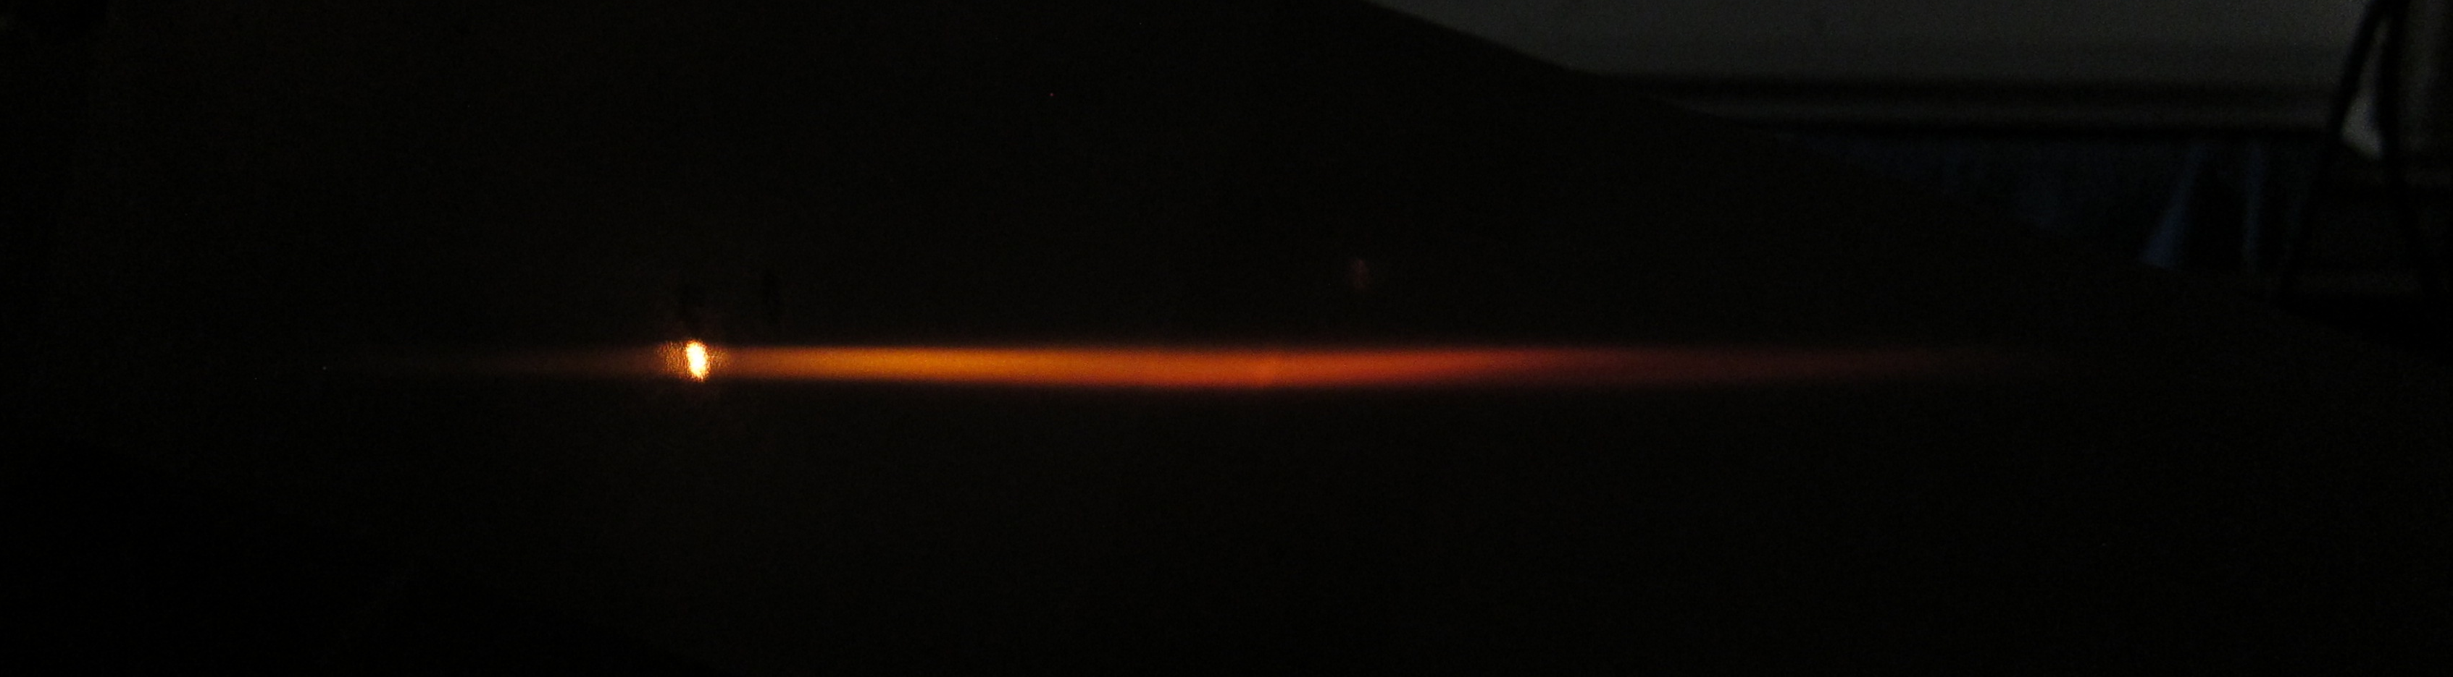
Spontaneous emission pollution
Or… when a laser isn’t perfect.
The ideal laser spectrum
The real laser spectrum
power
wavelength
Notes:
Our tapered amplifier is great because it’s a relatively inexpensive way to get several watts of power. Less than $5,000 to build the entire system from scratch. BUT, tapered amplifiers are notorious for producing a lot of broadband spontaneous emission in addition to the amplified light.

Slide 56
Spontaneous emission and polarizability
5 pm without filtering
0.5 pm with fiber filtering
MZW uncertainty due to spontaneous emission =

Slide 57
Circular polarization
Notes:
You might worry that our magic-zero wavelength measurement depends on the laser polarization. Individual FmF states do, in fact, have different mzws when the light has some component of circular polarization. However, we are saved by the fact that our atom beam is naturally unpolarized has an equal number of all FmF states.

Slide 58
Sources of contrast loss
Notes:
The last item that I want to comment on is relationship between photon scattering, decoherence, and precision in our measurement. On the bottom I’m showing you the same phase shift data that I showed you before, but on the top I’ve added the interferometer contrast. The black circles are the reference contrast when the light is off, and the red circles show the contrast when the light is on. As you’d expect, the scattering rate is high and the contrast is nearly 0 near resonance. But even at the tune-out wavelength the scattering rate remains large enough to be measureable.
So, let’s say that you want to make a higher precision measurement of this tune-out wavelength using an interferometer. How might you try to do it? One way might be to crank up the laser power, but that’s going to increase both the phase shift and the scattering rate in the same way. What about trying to use a cold atom interferometer where you have the benefit of long hold times? Well, I think that’s an even worse idea since you’ll give the atoms much more time to undergo spontaneous emission.
This year at DAMOP we’ve seen a lot of great talks on new or future precision measurements using atom interferometers.

Slide 59
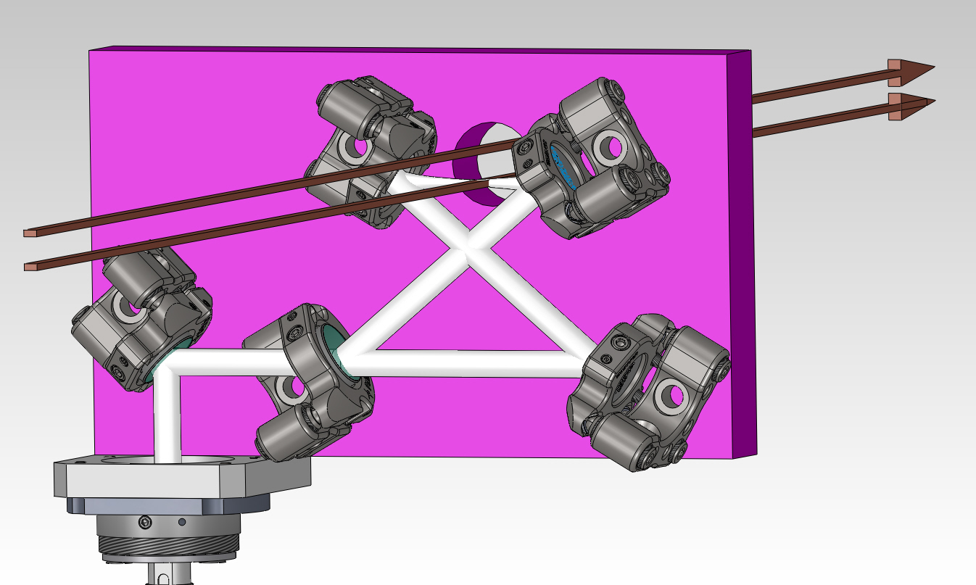
2nd generation experiment
Power build-up cavity
Hall of mirrors
Coaxial atom-light interaction

Slide 60
Magic-zero wavelength review and outlook
Theory: 768.9710(30) nm
This measurement: 768.9712(9) nm
Future MZW measurement possibilities in Arizona:
Atom | Theory (nm) | Measurements (nm)
K | 768.9710(30) 405.98(4) 404.72(4) | 768.9712(9)
Rb | 790.034(7) | 789.85(1) ???
Cs | 880.25(4) 460.22(2) 457.31(3)
Sr | 687 620
Notes:
It’s important to note that the theory uncertainty is very generous

Slide 61
What happens to an atom in an electric field?
1000 V
+
0 V

Slide 62
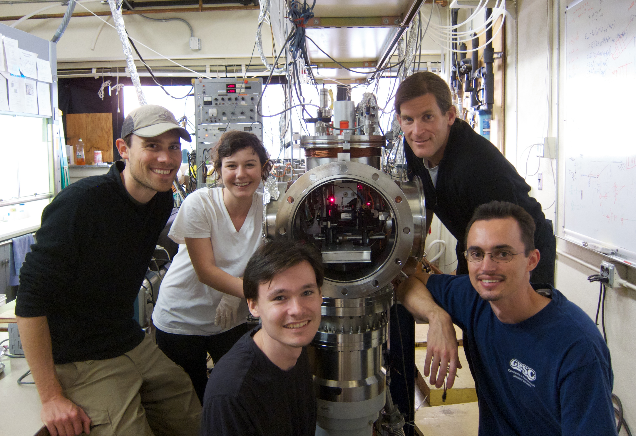
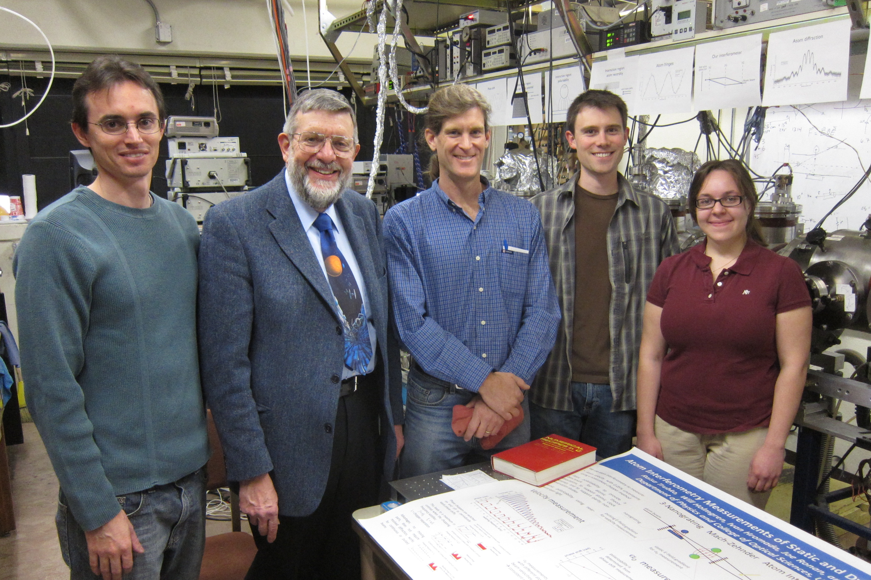
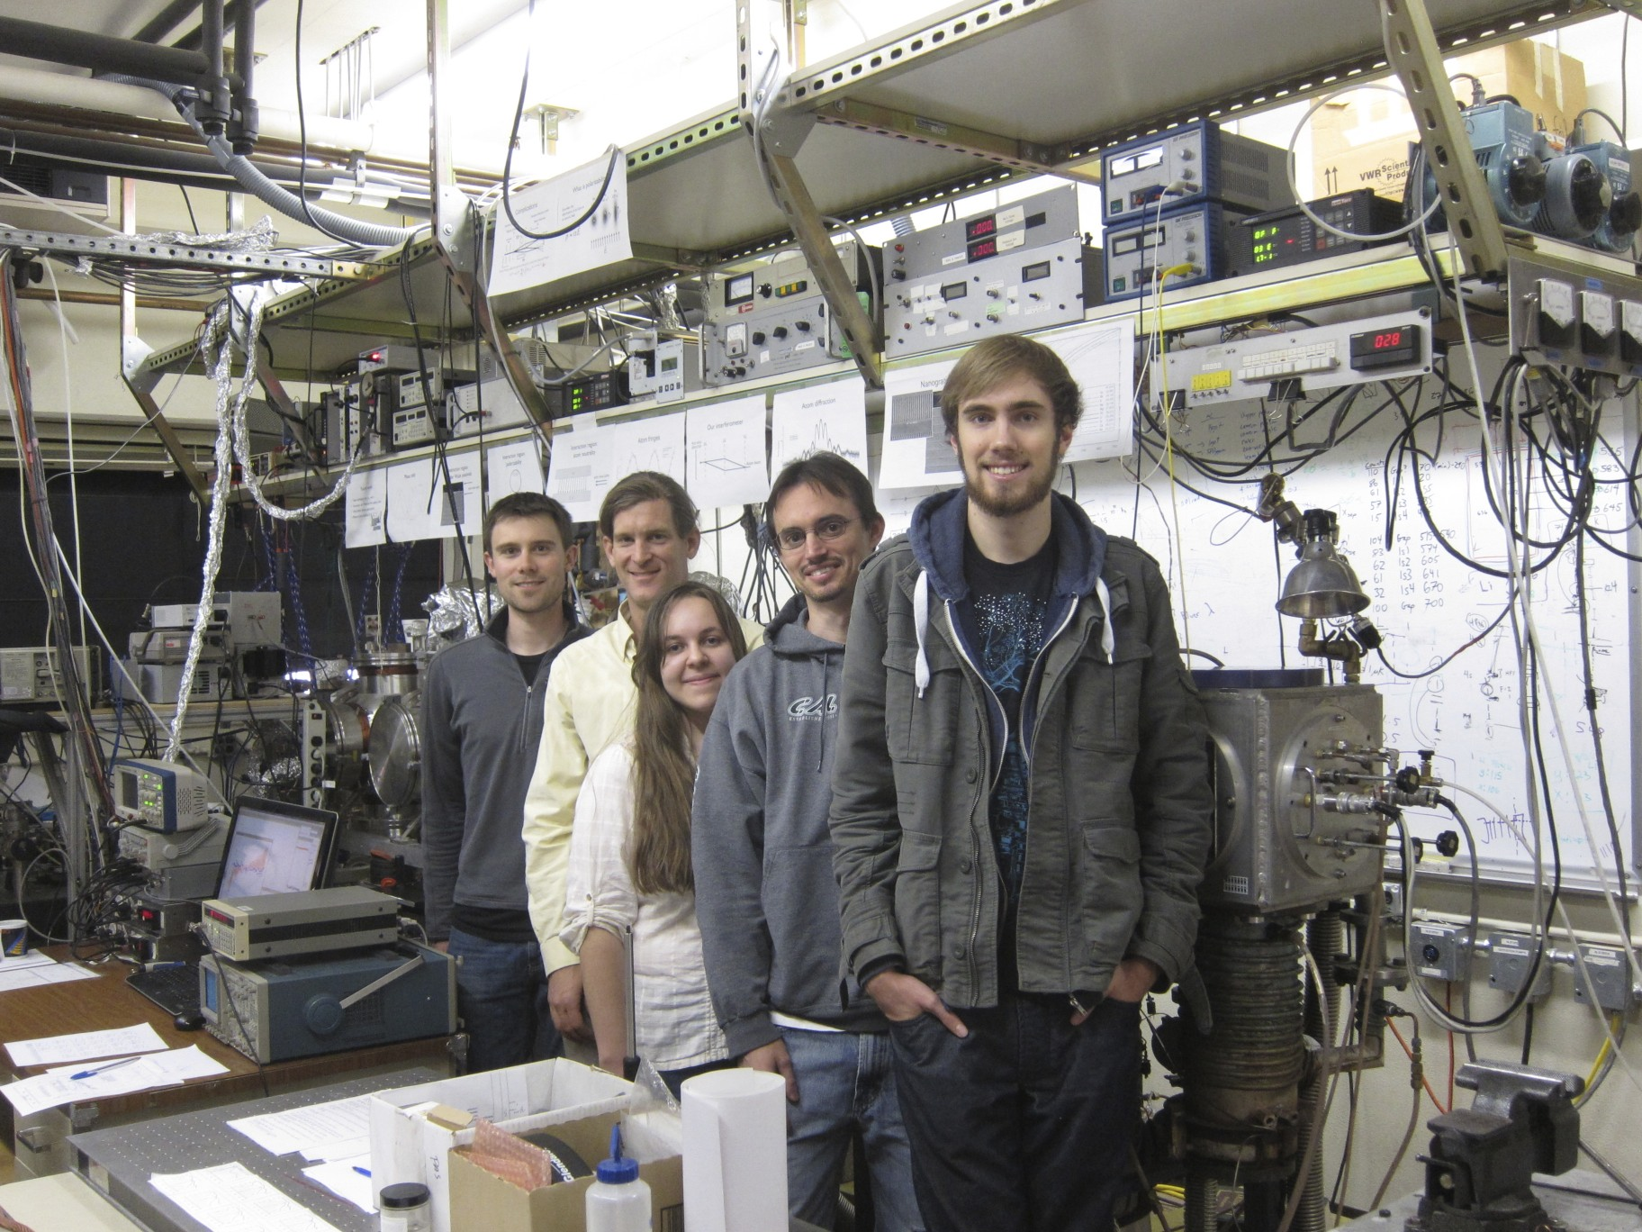
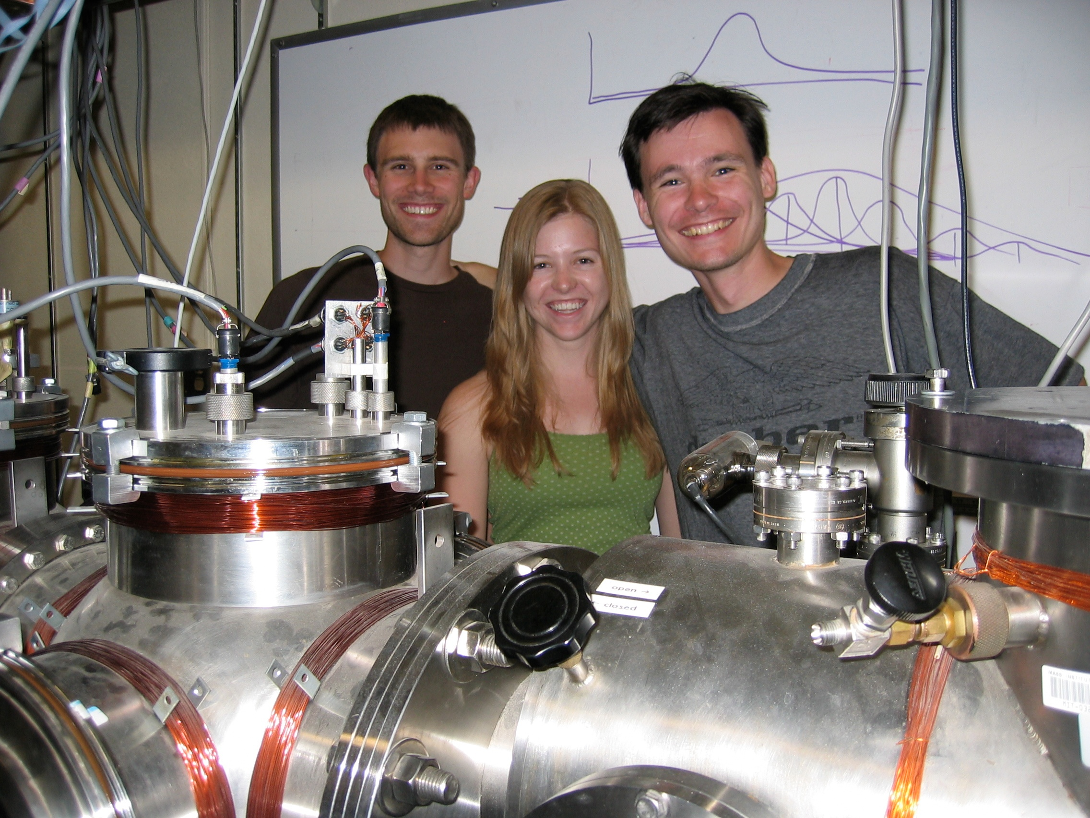
None of this would be possible without these great people… Thank you!

Slide 63

None of this would be possible without these great people… Thank you!

Slide 66
Back up slides

Slide 67
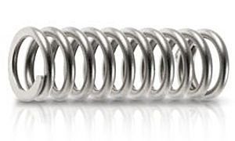
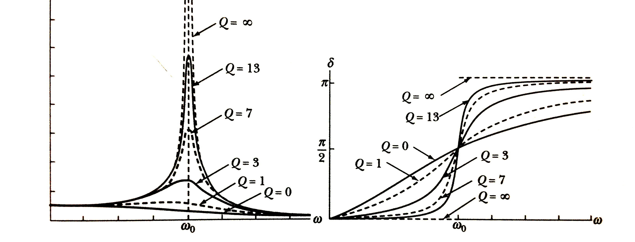
Atoms and oscillators
amplitude
phase
frequency
Thorton and Marion
Notes:
Spring constant k, mass m, omega_0 = sqrt(k/m).
Q of an atom? For alkalis, Omega_0 = 400 THz, delta omega = 4 MHz, Q = 10^8
Intercombination lines of atoms used for atomic clocks have Q = 10^14 or 10^15

Slide 68
Atoms and oscillators
Dipole moment
Polarizability

Slide 69
Atoms and oscillators
Static polarizability

Slide 70
Atoms and oscillators
Real part → index of refraction
Imag. part → absorption

Slide 71
Beam velocity
Rb
Measure de Broglie wavelength via diffraction
K
Na
The diffraction patterns look similar by design
Notes:
The largest contribution to the uncertainty in our polarizability measurements comes from uncertainty in the beam velocity and velocity distribution, so it’s worth discussing how we actually measure the velocity and velocity distribution. We measure the de Broglie wavelength by measuring the diffraction pattern, and thus the diffraction angle of the beam, from just the first grating . The finite beam and detector widths and the velocity distribution all cause broadening of the diffraction pattern. We measure beam velocity with better than 1/4% uncertainty.
But, notice how similar the diffraction patterns look! We’ve tuned the different beam velocities to yield similar diffraction angles for each atomic species. Therefore, most systematic effects related to beam velocity will cancel out when we perform ratio measurements.

Slide 72
Looks something like this…
except the laser’s red

Slide 73
Sr photoionization scheme

Slide 74
Dimers
Two unique orientations of a homonuclear dimer in an electric field
Difference in polarizability leads to a unique contrast loss signal
Contrast
Applied field

Slide 75
Our polarizability experiment
Published in: Holmgren et al. PRA 2010
Notes:
I hope you’re all motivated to learn about our polarizability experiment now.
Again, we use a supersonic beam with a three grating Mach-Zehnder atom interferometer to measure polarizabilities. These gratings are made of silicon-nitride and have a period of 100 nm. We place these two electrodes, a cylinder and a grounded plane, across the interferometer. When we apply a voltage across the electrodes the resulting electric field *gradient* causes a phase shift in the observed fringe pattern. One path of this interferometer might acquire an interaction phase phi-0 of say, 1000 radians, while the other acquires a phase phi-1 of 995 radians, so we would measure a 5 radian phase shift of our fringe pattern.
Note that the interaction phase is proportional to the polarizability, the integral of E-squared along the path, and inversely proportional to velocity.

Slide 76
Velocity measurement improvements with length gauge

Slide 77
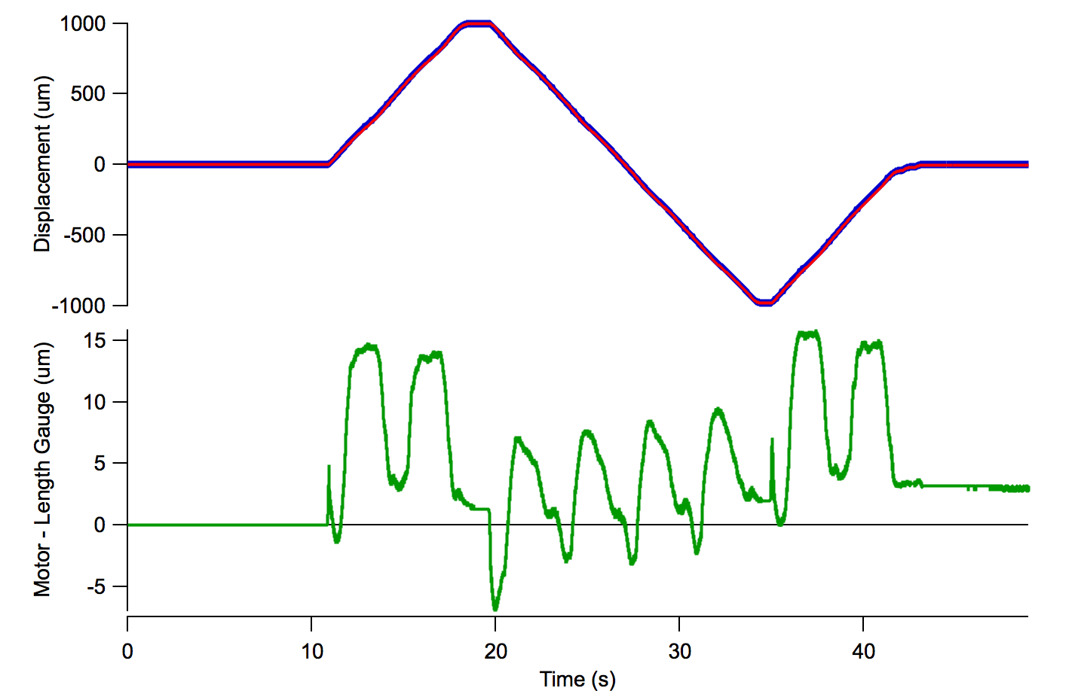
Velocity measurement improvements with length gauge

Slide 78
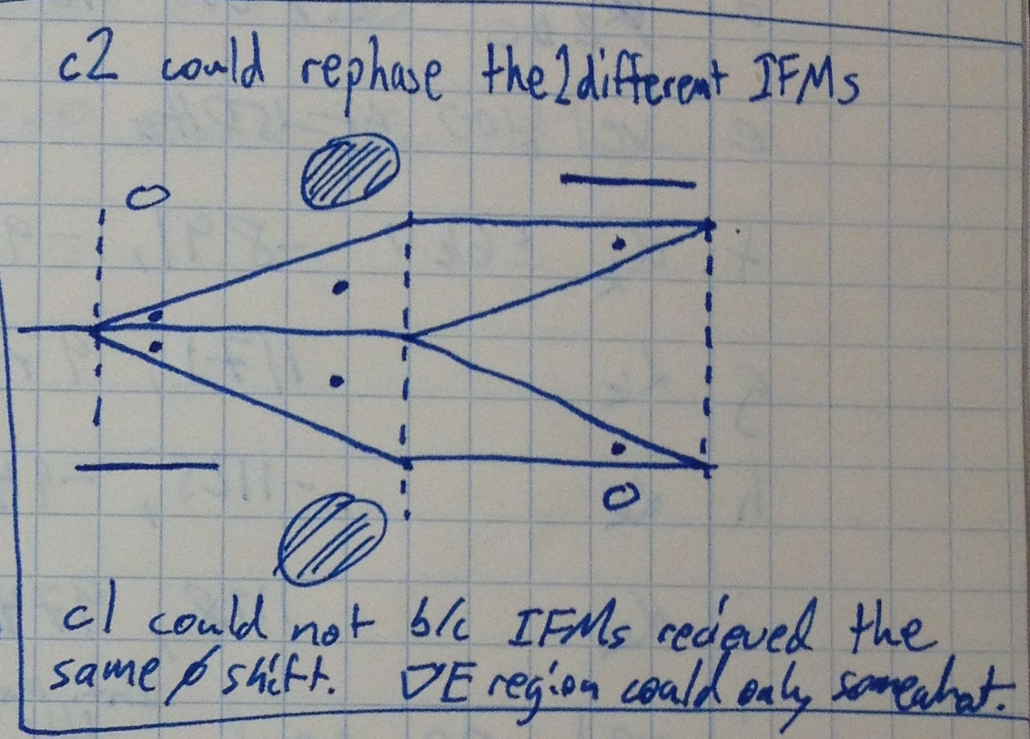
Phase choppers and matter wave lenses

Slide 79
Phase choppers and matter wave lenses

Slide 80
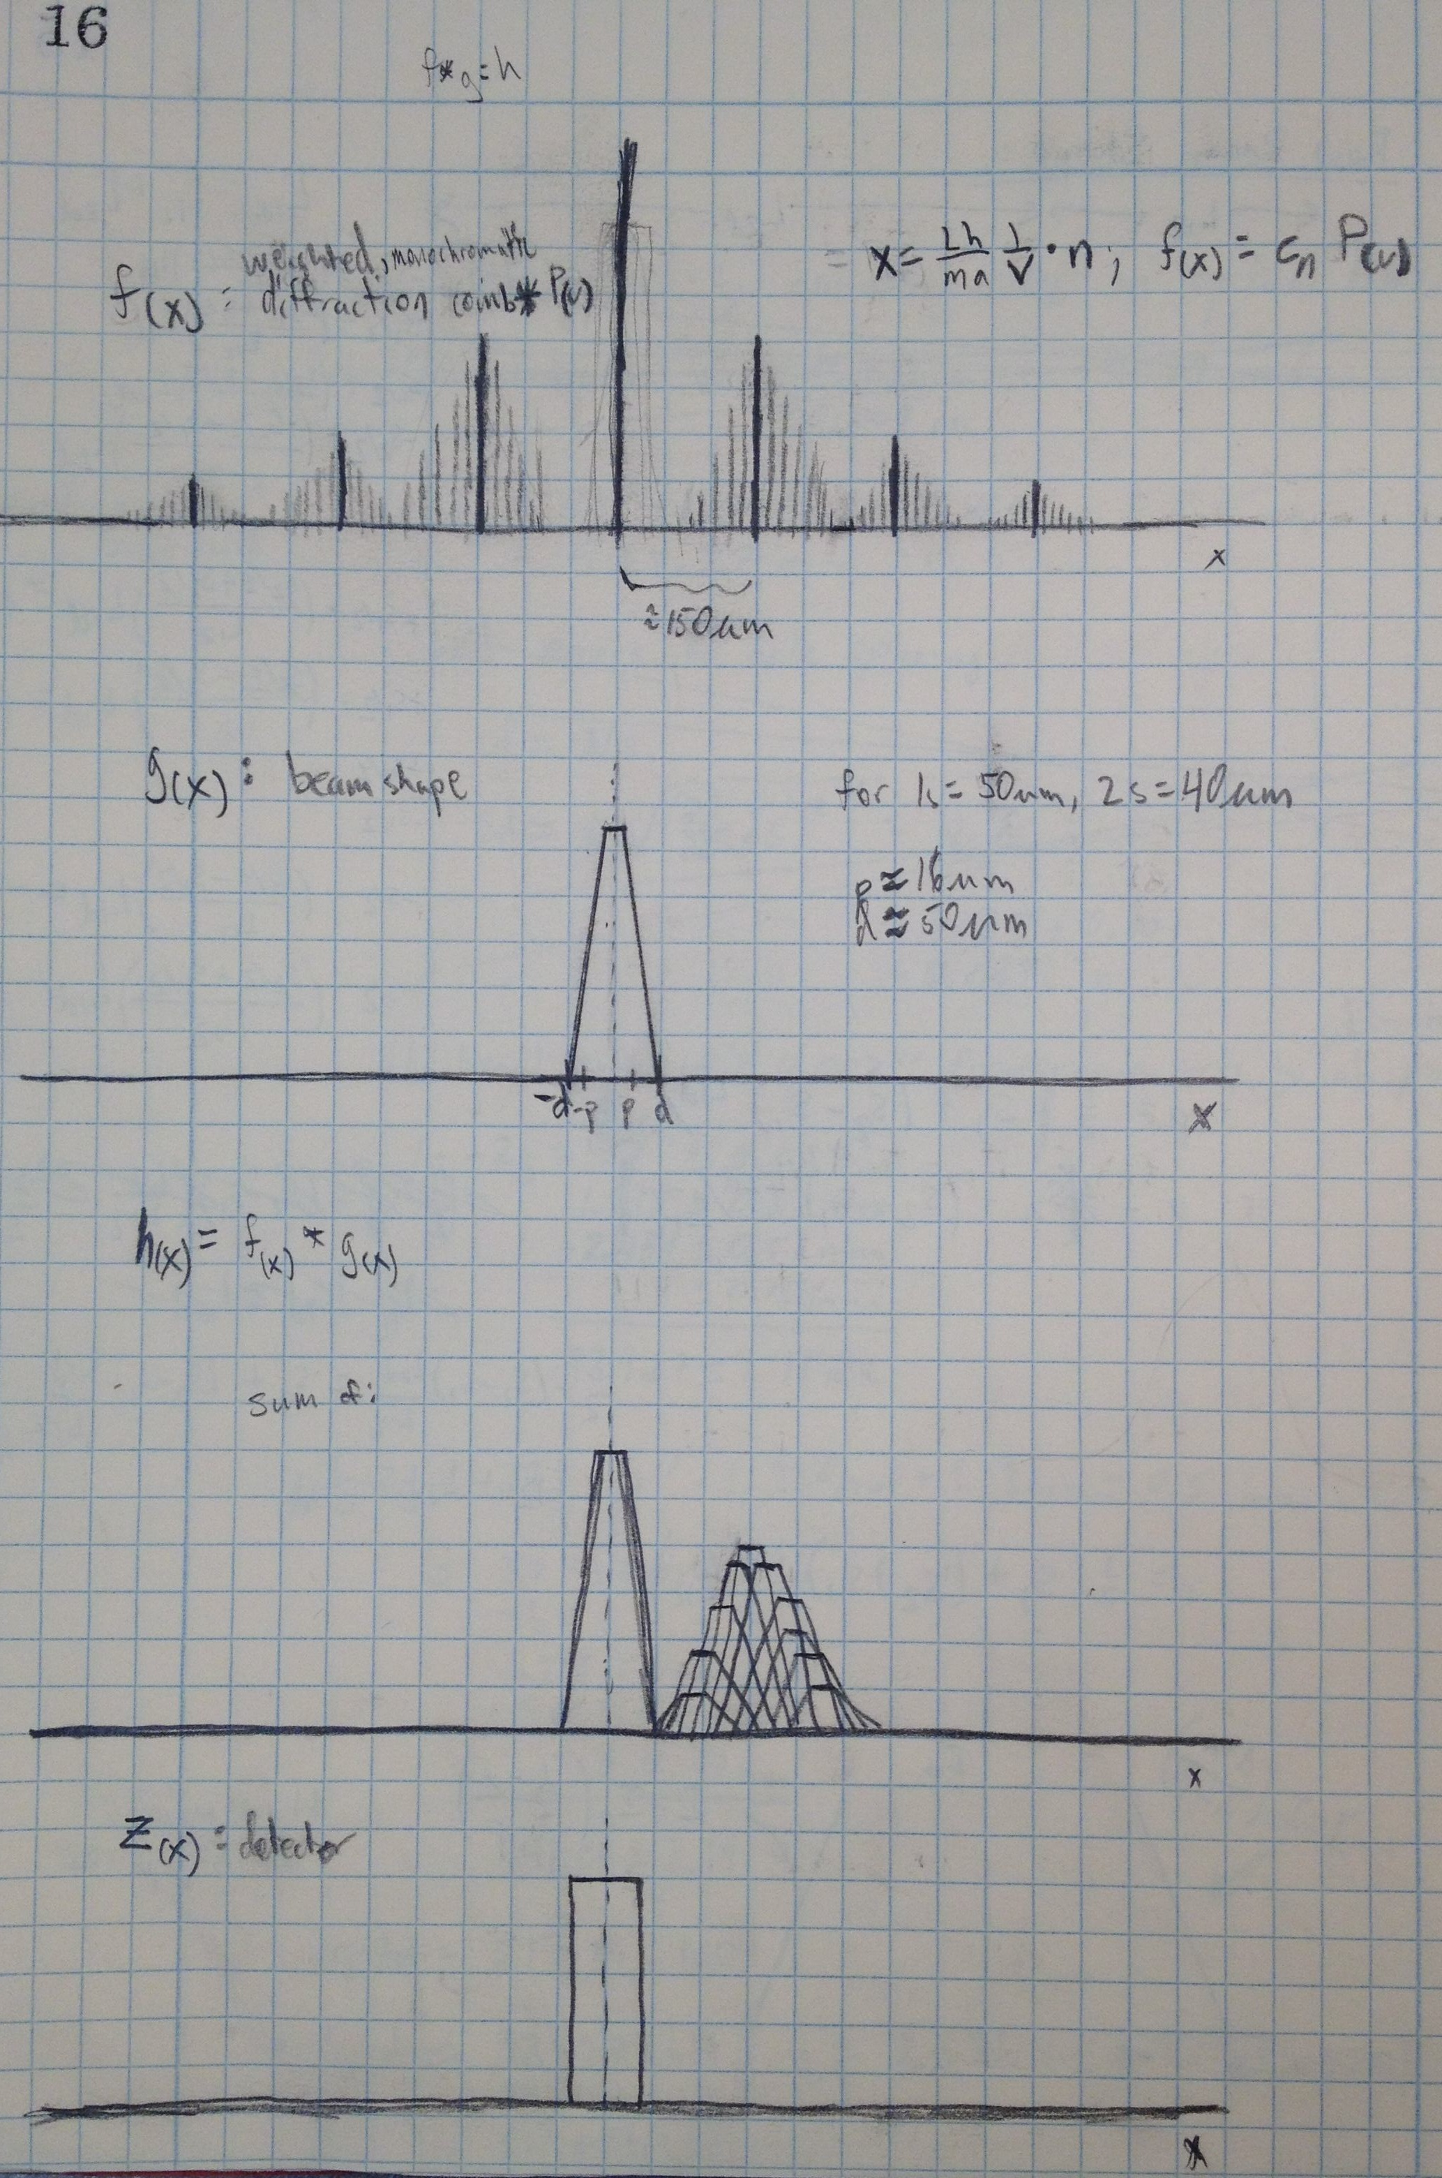
Convolutions for diffraction
Diffraction comb for different velocity classes
Beam shape
Beam shape convolved with P(v) comb
Detector shape

Slide 81
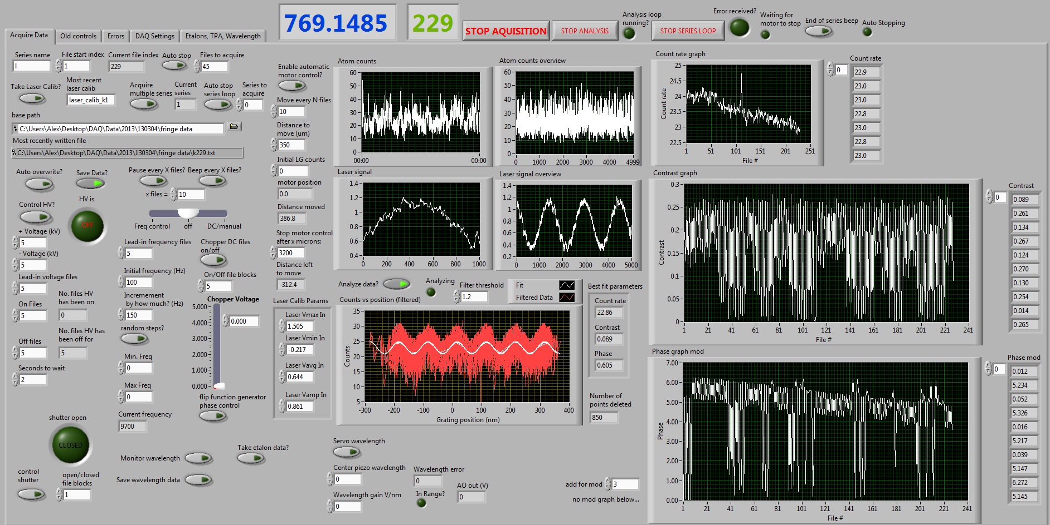
New DAQ

Slide 82
Van der Waals C3 measurements
I₂
I₃
Rb
detector
nanograting
Atom
beam
K
Counts/sec
Na
Detector position

Slide 83
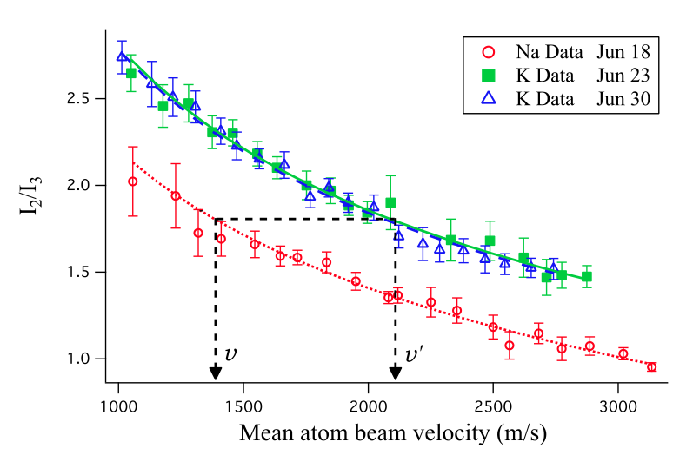
Van der Waals C3 measurements
so

Slide 84
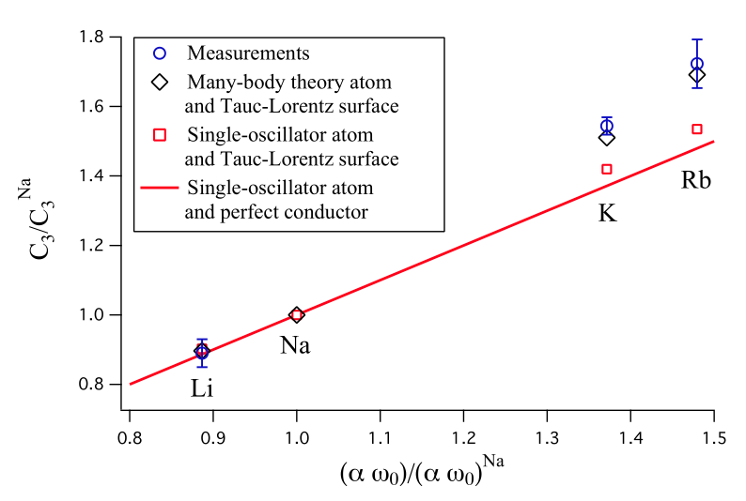
Van der Waals C3 measurements
Atom diffraction reveals the impact of core-electrons (Lonij, 2010 PRL)

Slide 85
What happens to an atom in an electric field?
1000 V
+
0 V

Slide 86
What happens to an atom in an electric field?
1000 V
+
0 V

Slide 87
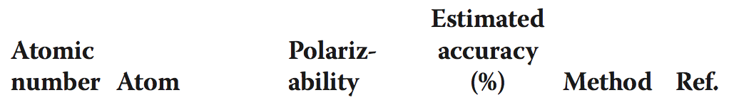
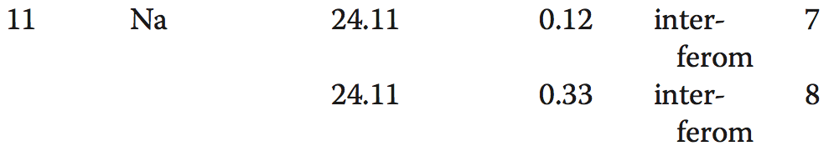
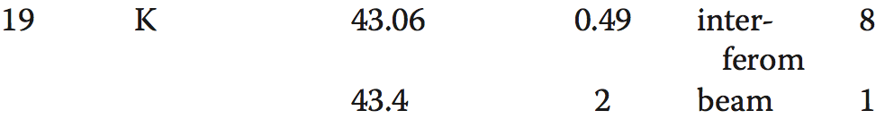
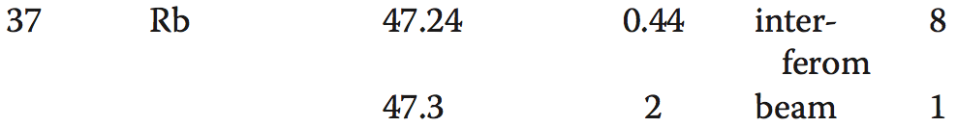

Slide 88
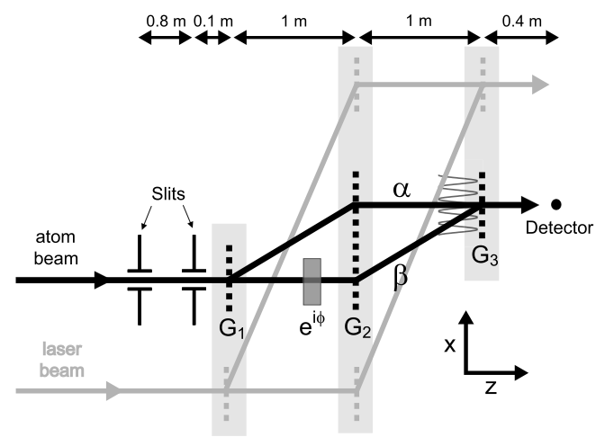
IFM in more detail
John Perreault, PhD Thesis, U of A, 2005

Slide 89
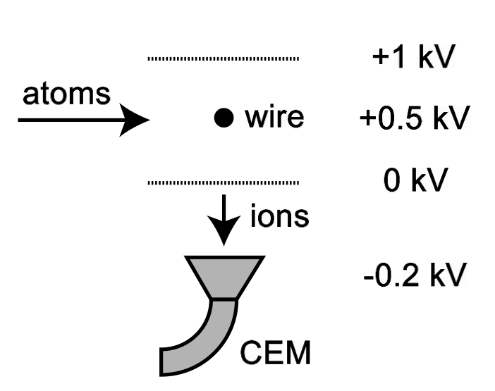
Hot wire detector
John Perreault, PhD Thesis, U of A, 2005

Slide 90
Phase choppers for velocity measurement
Pulsed electric fields periodically apply π phase shifts
Interferometer contrast oscillates as we change the chopping frequency f
Max contrast when f = n v/L = n f₀
Published in: Holmgren et al. NJP 2011

Slide 91
Phase choppers for velocity measurement
Pulsed electric fields periodically apply π phase shifts
Interferometer contrast oscillates as we change the chopping frequency f
Max contrast when f = n v/L = n f₀

